Slide 1


Analysis of and Mitigation Strategies for Real World ICS Security Incidents
Nico Fechtner
nico.fechtner@tum.de
July 9, 2020
Notes:
Notes

Slide 2
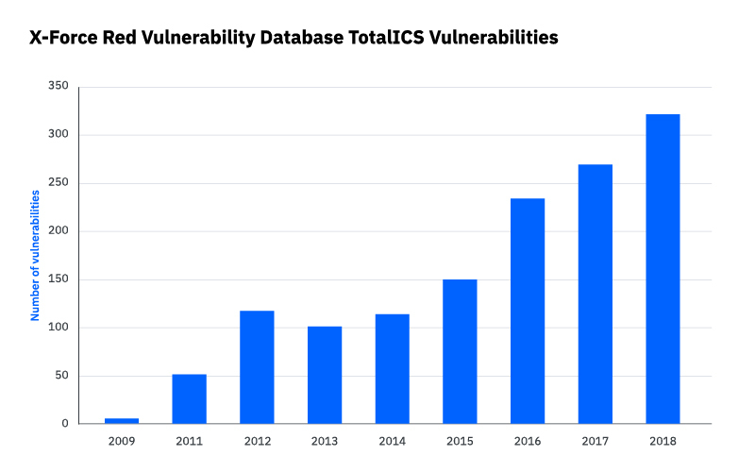
Motivation: Growing ICS Threat Landscape
https://securityintelligence.com/posts/industrial-control-systems-security-to-test-or-not-to-test/
2
Notes:
[Cover years 2016 – 2018 first with a white block]
IBMs X-Force Red offers penetration testing
Connectivity

Slide 3
Problem Statement
Defend against ICS attacks
Avoid known/common mistakes
Learn from past incidents
Comparative overview of historic incidents
+
In-depth analyses of individual incidents
3
Notes:
Animate last point bold

Slide 4
Agenda
Motivation & Problem Statement
Comparative Overview of ICS Security Incidents
Case Study: The Triton Attack
Conclusion & Future Work
4

Slide 5
Agenda
Motivation & Problem Statement
Comparative Overview of ICS Security Incidents
Case Study: The Triton Attack
Conclusion & Future Work
5

Slide 6
Analyzed Incidents
Comparative Overview of ICS Security Incidents
Incident enumerations (Risi database, ICS-CERT alerts)
Threat reports from ICS security companies
Papers / conference talks dedicated to single incidents
Press releases / blog posts dedicated to single incidents
27 incidents analyzed
6
Notes:
How did I select the incidents?

Slide 7
Targets
Comparative Overview of ICS Security Incidents
7

Slide 8
Targets
Comparative Overview of ICS Security Incidents
8

Slide 9
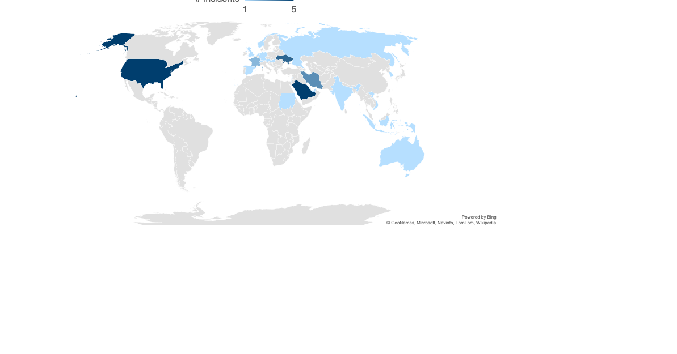
Targets
Comparative Overview of ICS Security Incidents
9
Notes:
Entities in Europe are targeted by about 37%
Middle East is being targeted by about 33%
19% of the analyzed incidents, the US were amongst the victims
neither Russia nor China nor North Korea report a lot of ICS incidents against entities located in their countries

Slide 10
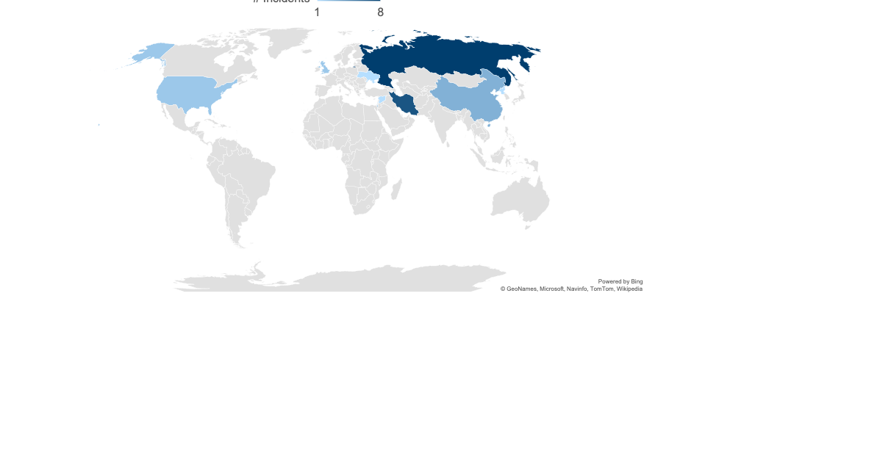
Threat Actors
Comparative Overview of ICS Security Incidents
10
Notes:
Entities in Europe are targeted by about 37%
Middle East is being targeted by about 33%
19% of the analyzed incidents, the US were amongst the victims
neither Russia nor China nor North Korea report a lot of ICS incidents against entities located in their countries

Slide 11
Threat Actors
Comparative Overview of ICS Security Incidents
11

Slide 12
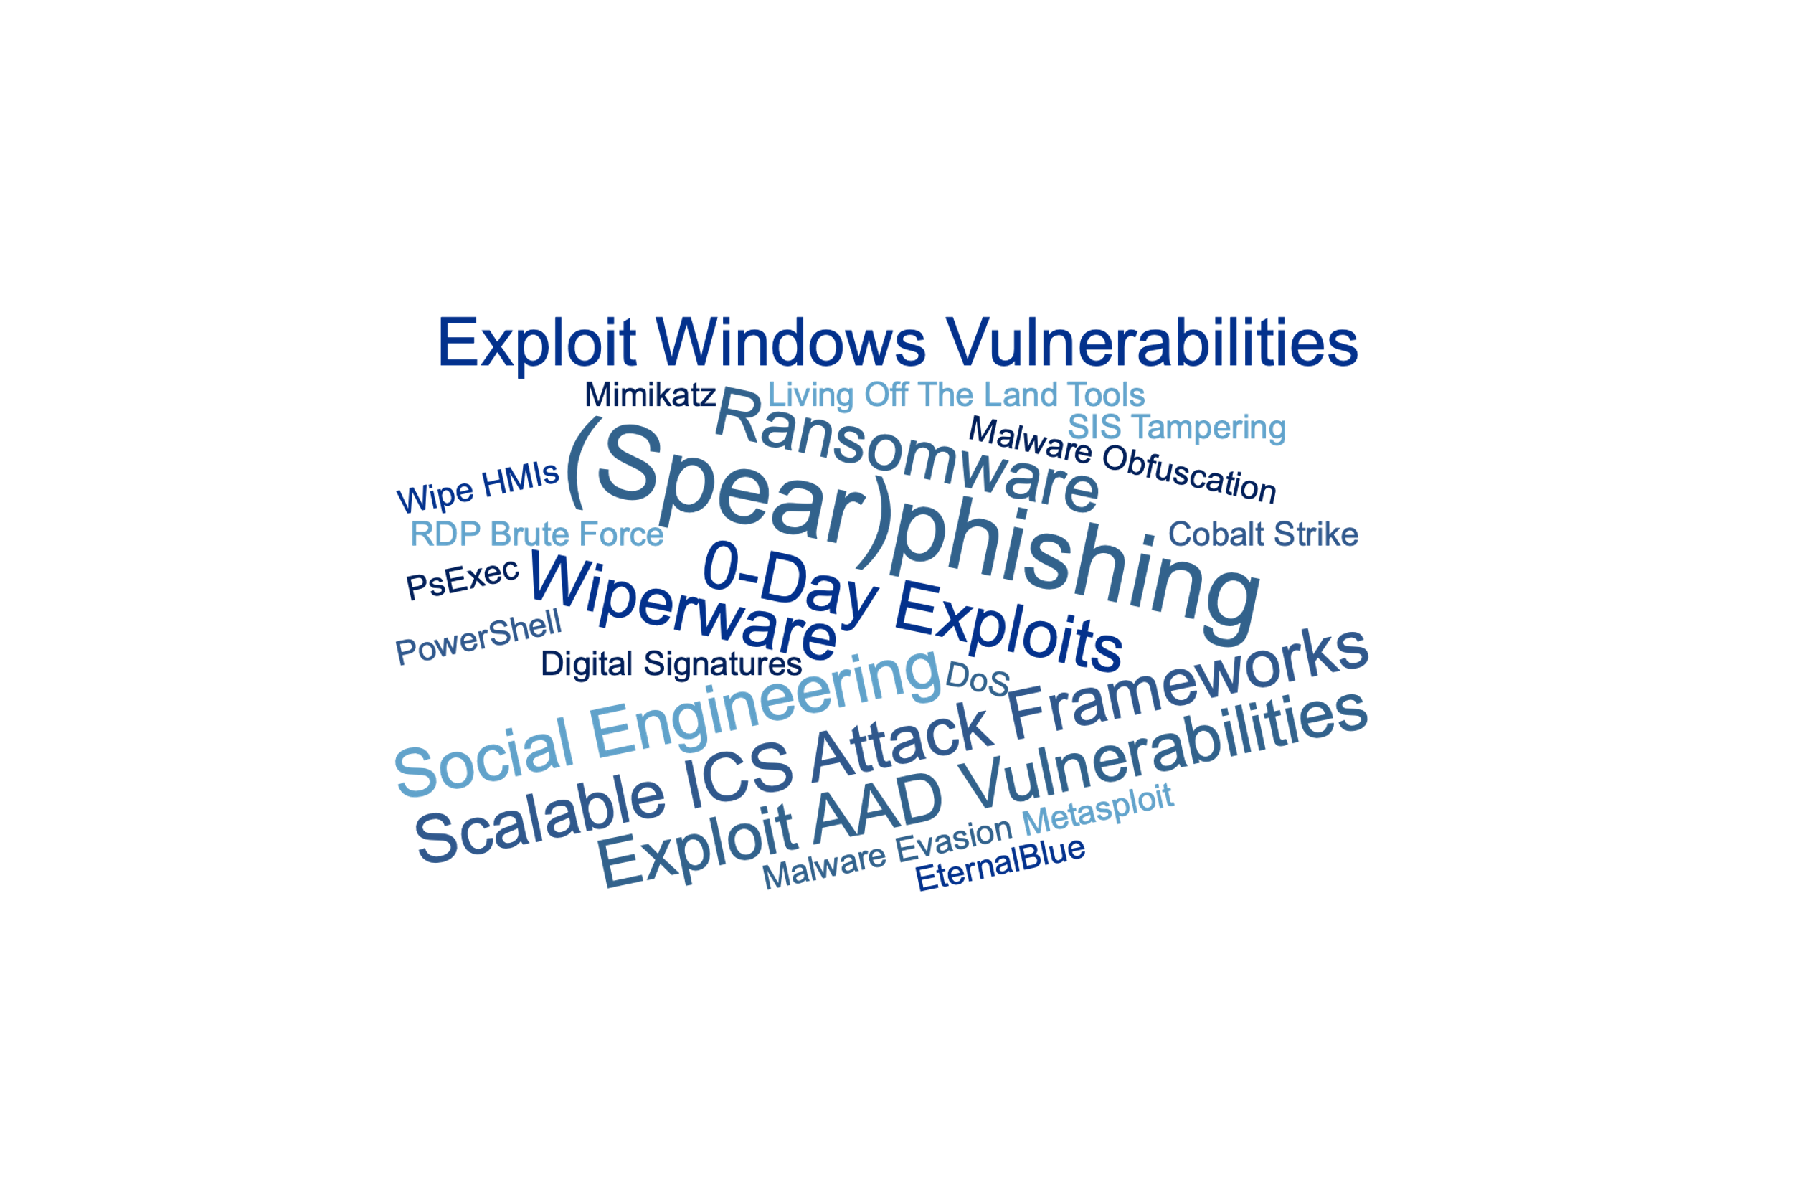
Attack Techniques
Comparative Overview of ICS Security Incidents
12

Slide 13
Attack Goals and Motivations
Comparative Overview of ICS Security Incidents
Monetary Gain
Information Gain
(Physical) Disruption
13

Slide 14
Success Rate
Comparative Overview of ICS Security Incidents
14

Slide 15
Dwell Times
Comparative Overview of ICS Security Incidents
Dwell Time of untargetted attacks: Days
Dwell Time of targetted attacks: Months – Years
In theory a lot of time to detect and prevent the execution of a payload
In practice most attacks still are not detected in their early stages
15

Slide 16
Detection and Mitigation Strategies
Comparative Overview of ICS Security Incidents
Up-to-date asset inventory
Intrusion detection/prevention systems (IDS)
Increasing the security awareness of employees
Vulnerability management solutions
Solid backup strategy
16

Slide 17
Agenda
Motivation & Problem Statement
Comparative Overview of ICS Security Incidents
Case Study: The Triton Attack
Conclusion & Future Work
17

Slide 18
Safety Instrumented Systems (SIS)
Case Study: The Triton Attack
Goal: Maintain safe operations and prevent catastrophic events in case of failures of other hard- or software.
Sensors
SIS
Actuators
Temperature
Heater
Is it safe to continue operation?
Preassure
No
Graceful shutdown
Waterpump
.
.
.
.
.
.
Velocity
Yes
Engine
Do nothing
18

Slide 19

Attack and Response Strategies
Case Study: The Triton Attack
Still unclear how the ICS network got breached; possibly through spearphishing
http://mcgtechtalk.com/wp-content/uploads/2017/03/spear-phishing.png
19

Slide 20

Attack and Response Strategies
Case Study: The Triton Attack
Since the network connectivity of the SIS was not strictly limited, the attackers could access it
https://manageditservicesminneapolis.com/importance-computer-network-maintenance-repair-info/
20

Slide 21
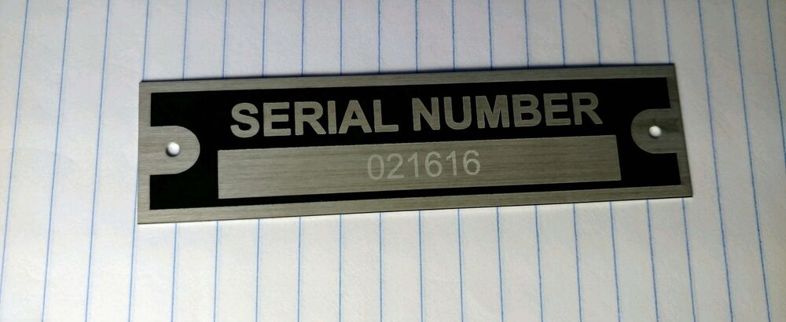
Attack and Response Strategies
Case Study: The Triton Attack
Attackers figured out the exact SIS model and left for two years
https://i.ebayimg.com/images/i/152654640334-0-1/s-l1000.jpg
21

Slide 22

Attack and Response Strategies
Case Study: The Triton Attack
Since the SIS ran in programming instead of run mode, the Triton malware could be installed
http://hw-img.datpiff.com/m580a552/A-Mase_Two_Years_Later-front-large.jpg
22

Slide 23

Attack and Response Strategies
Case Study: The Triton Attack
After installation and execution, the plant tripped gracefully
https://unstrangemind.files.wordpress.com/2016/03/shutdown.jpg
23

Slide 24

Attack and Response Strategies
Case Study: The Triton Attack
Due to a programming error, the malware contained a bug
https://www.beningo.com/wp-content/uploads/2016/03/AdobeStock_100096286.jpeg
24
Notes:
Human error

Slide 25

Attack and Response Strategies
Case Study: The Triton Attack
After some investigations, the plant was brought up again
https://betanews.com/wp-content/uploads/2016/11/Restart-button-keyboard-key-e1479117780695.jpg
25

Slide 26

Attack and Response Strategies
Case Study: The Triton Attack
The attackers got a second chance, tried to fix the bug and installed Triton again
https://betanews.com/wp-content/uploads/2016/08/install-software-laptop.jpg
26

Slide 27
Attack and Response Strategies
Case Study: The Triton Attack
Due to the bug not being patched correctly, the plant tripped again
https://unstrangemind.files.wordpress.com/2016/03/shutdown.jpg
27
Notes:
Human error

Slide 28

Attack and Response Strategies
Case Study: The Triton Attack
Hired ICS security specialists were finally able to identify and remove the malware
https://www.cbronline.com/wp-content/uploads/2017/02/Investigation.jpg
28

Slide 29
Goals, Impacts, and Attribution
Case Study: The Triton Attack
Goal: remains unclear; probably to cause disruption
Impact: Several weeks of downtime
Attribution: State-sponsored Russian threat group named TEMP.Veles
29

Slide 30
Detection and Mitigation Opportunities
Case Study: The Triton Attack
Continuous security awareness trainings can help employees to identify phishing attacks
Restricting the network connectivity of a SIS lowers the possibility of a SIS breach
Under normal circumstances, SIS should always operate in run mode, not in program mode in order to prevent reprogramming of the logic by attackers
30
Notes:
Animate last point bold

Slide 31
Agenda
Motivation & Problem Statement
Comparative Overview of ICS Security Incidents
Case Study: The Triton Attack
Conclusion & Future Work
31

Slide 32
Conclusion
Untargeted attacks are becoming increasingly important
Most attacks are considered to be state-sponsored
Important trends in terms of attack techniques are spearphishing, zero-day exploits, sophisticated obfuscation and evasion techniques, and living off the land tools
The most common goals of ICS attacks are data extraction and causing disruption
Attackers usually reside in the victims’ network for several weeks or months before executing the final payload
32

Slide 33
Conclusion
Up-to-date asset inventories
Intrusion detection/prevention systems (IDS)
Increasing the security awareness of employees
Vulnerability management solutions
Solid backup strategies
33

Slide 34
Future Work
Add more incidents for higher accuracy and deeper insights
Use an analysis approach that is more qualitative instead of quantitative
Analyze how ICS companies manage to defend against known threats over the course of time
34

Slide 35
Q & A
35

Slide 36
Backup
36

Slide 37
Analyzed Incidents
Comparative Overview of ICS Security Incidents
37
Notes:
Animate last point bold

Slide 38
Comparative Overview of ICS Security Incidents
Targets
Threat actors
Attack techniques
Attack goals and realized impacts
Dwell times and reactions
Detection and mitigation strategies
38
Notes:
Evtl. rausnehmen

Slide 39
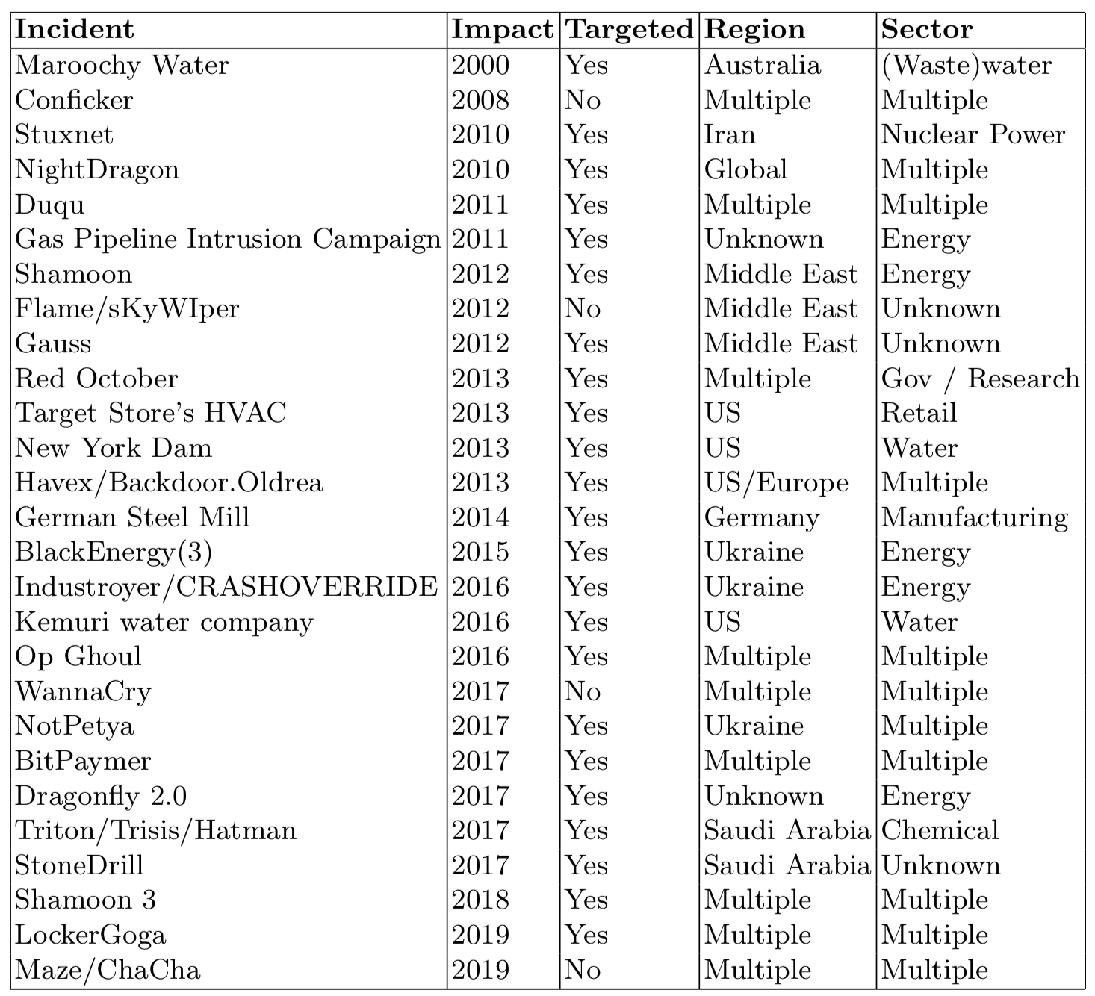
Analyzed Incidents
39
Notes:
Evtl. rausnehmen

Slide 40
Threat Actors
Comparative Overview of ICS Security Incidents
40

Slide 41
Attack and Response Strategies
Case Study: The Triton Attack
Unclear how the ICS network got breached; possibly through spearphishing
Since the network connectivity of the SIS was not strictly limited, the attackers could access it
Attackers figured out the exact SIS model and left for two years
Since the SIS ran in programming instead of run mode, the Triton malware could be installed
41

Slide 42
Attack and Response Strategies
Case Study: The Triton Attack
After installation and execution, the plant tripped gracefully
Due to a programming error, the malware contained a bug
After some investigations, the plant was brought up again
The attackers got a second chance, tried to fix the bug and installed Triton again
Due to the bug not being patched correctly, the plant tripped again
Hired ICS security specialists were finally able to identify and remove the malware
42

